Slide 1
Predicting Loan repayment based on data from LendingClub.com
Perry Antonelli

Slide 2
Data set
Found on Kaggle.com, originally from LendingClub.com
Contains lending data from 2007-2010
Target variable is whether the borrower paid back the loan in full
Features include: the purpose for the loan, the interest rate, the fico score of the borrower, and the log of the borrower’s annual income, among other things.
There is no missing data in this data set.
9578 data points and 14 features
Set aside 20% of the data points to be used as testing at the very end

Slide 3
False Positives and False Negatives
A false positive would be predicting that someone will not fully pay back a loan when in realty they would pay it back
A false negative is the opposite situation, predicting that someone will fully pay back a loan when they would not
False negatives are more costly than false positives, so the business metric is F-2 score.
Notes:
A false positive would be predicting that someone will not fully pay back a loan when in realty they would pay it back. The cost of a false positive is then the cost of not giving someone a loan: the loss of the profit you would get from that loan.
A false negative is the opposite situation, predicting that someone will fully pay back a loan when they would not. The cost of a false negative is then the loss of the profit you would get from that loan along with some portion of the loan itself.
The metric of interest is then a version of the F-score that weights false negatives more than false positives. (recall more than precision)

Slide 4
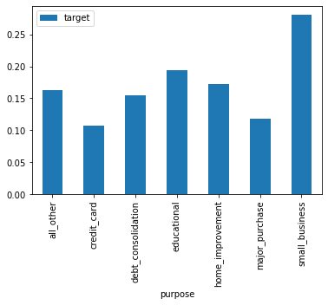
Data exploration
For each categorical feature a bar chart showing the percentage of the data that had target = 1 for each label of that feature
If the bars are all the same height, then that feature is a poor predictor. If they are all different it’s a good predictor.
All the categorical features are good predictors.

Slide 5
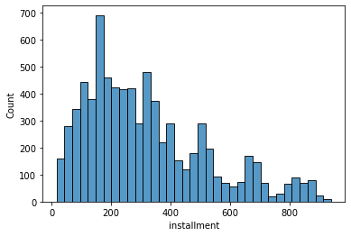
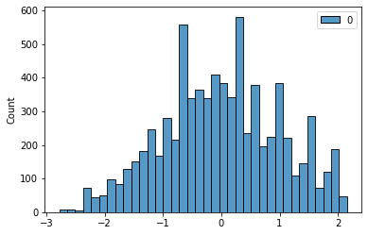
Data exploration
For numerical features histograms of the feature were plotted to see it’s distribution
If the feature does not follow a normal distribution, a power transform will be used to attempt to make it normal.

Slide 6
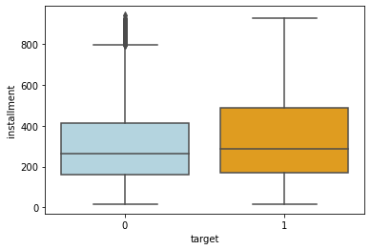
Data exploration
Box plots were also made showing how the distribution of the feature changes based on the value of the target variable.
The more different these distributions are the better the feature is as a predictor.

Slide 7
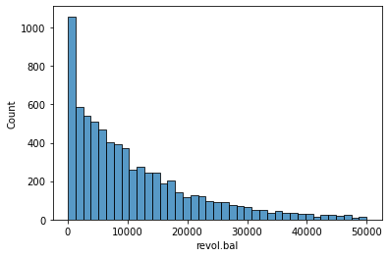
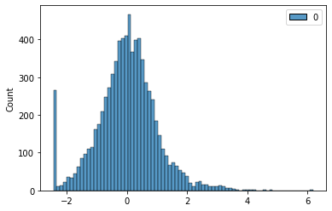
Data exploration
A couple of the features had many data points with that feature equal to zero.
For each these features a new feature was constructed that is 1 exactly when that feature is 0.

Slide 8
Feature engineering and Preprocessing
Power transformation - 'installment', 'fico’, and 'revol.bal’
Omit features - 'log.annual.inc', 'dti', 'days.with.cr.line’, and 'inq.last.6mths’
New features - 'revol.bal.zero', 'revol.util.zero’
All numerical features were also scaled by subtracting the mean and dividing by the standard deviation
All categorical features were one-hot encoded.
Separated out an additional 20% of data as validation data.
Notes:
Omit worst predictors
8 different preprocessors
Only necessary for the logistics regression. Might make it better
Trees will “figure it out” on their own

Slide 9
Models
Logistics Regression
Decision Tree
Random Forest
GBM (Gradient Boosting)
Notes:
Logistics – very simple baseline, if a complicated model can’t at least beat this it is bad
Decision Tree – conceptually simple, tends to overfit
Random Forest – multiple random decision trees
GBM – multiple decision trees built sequentially
‘balanced’ option for all but GBM

Slide 10
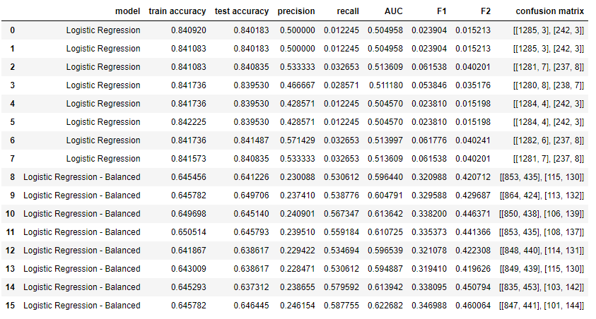
Logistics Regression
Notes:
8 different preprocessors with and without ‘balanced’ option
Balanced option handles unbalanced data better, prevents model from predicting everything as more common class of target variable
Best option is without any feature engineering

Slide 11
Tree-based models
Performed a grid search to tune hyperparameters of each model
No need for feature engineering
Parameters for each model
Forest: ccp_alpha=0.015, class_weight='balanced’, criterion='entropy', max_depth=5, max_features=0.1, n_estimators=4
GBM: ccp_alpha=0, learning_rate=1, max_depth=25, n_estimators=4
Tree: ccp_alpha=0, class_weight='balanced’, max_depth=5, max_features=0.1, min_samples_leaf=5

Slide 12
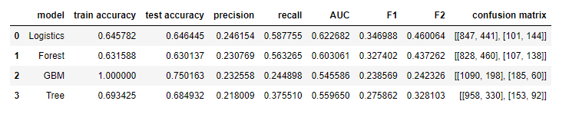
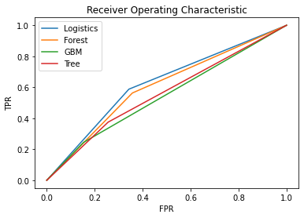
Training Results
Notes:
The logistics regression is the best model. It scores the highest in the metric of interest, F2-score, and has the highest precision, recalls, and AUC. Its ROC curve is also higher (closer to the top left corner) than all the others.
It's still not great, it's only identifying about 60% of the people that will not fully pay loans (recall = .58) and 75% of those it identifies as not fully paying back their loan will fully pay it.
Random Forest does the second best and maybe if the hyperparameters were adjusting better it could outperform the logistics regression.
GBM is overfitting to the data, it does amazing on the training data but underperforms on the test data. This could probably be fixed by further hyperparameter fitting or special treatment for the unbalanced dataset.

Slide 13
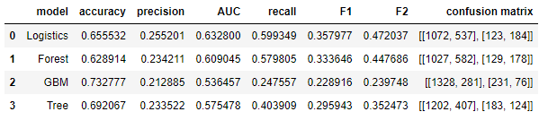
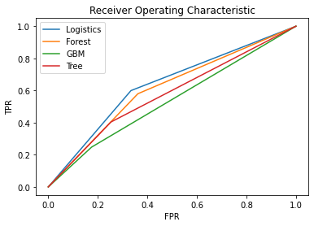
Training Results
Notes:
The logistics regression is the best model.

